Slide 1
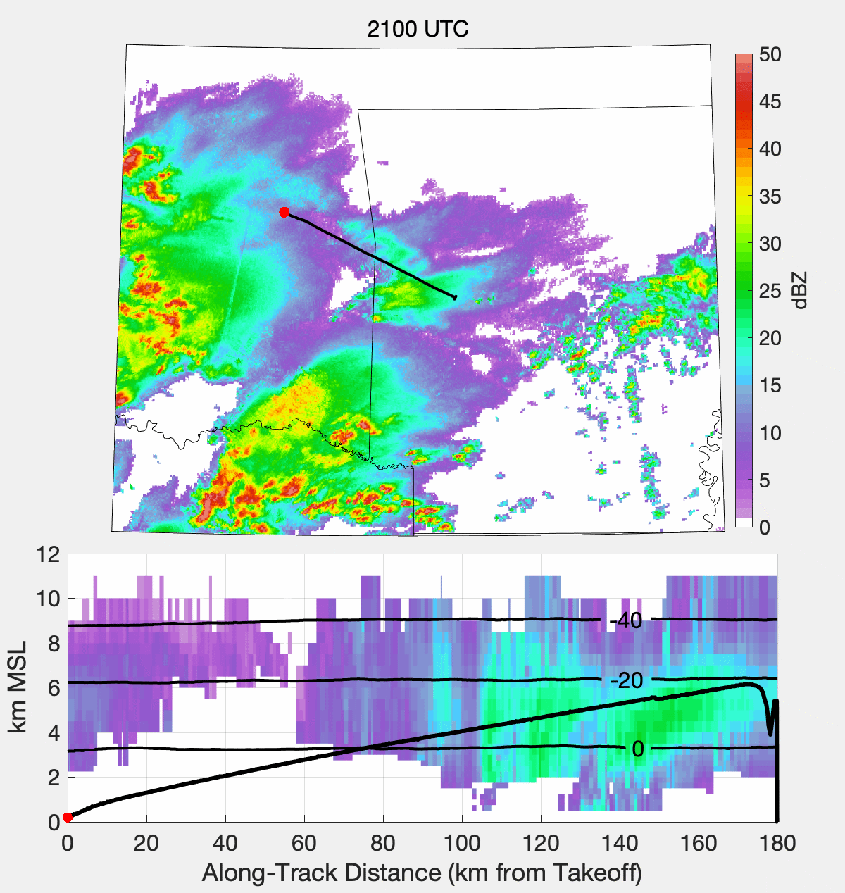
Each frame in this animation shows a single radar valid time

